Slide 1
P3 Intro

Slide 2
Planet Wars
The Game
Based off Galcon
Rules
Enemy ships cancel each other out when they battle
Conquered planets produce ships each turn
The more ships there, the faster they are produced
The numbers on the planet indicate how many ships it will take to conquer it

Slide 3
Planet Wars
How to win
Destroy all enemy ships or conquer all the planets

Slide 4
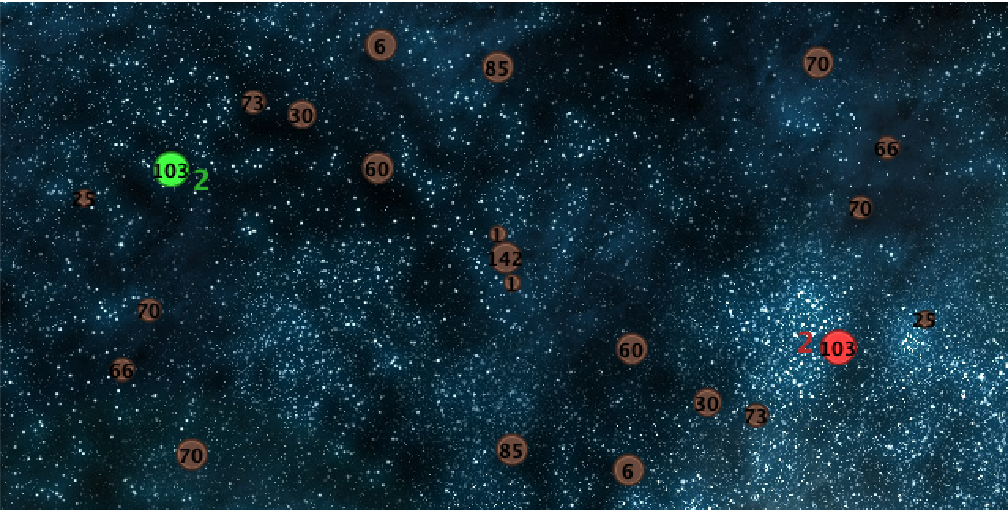
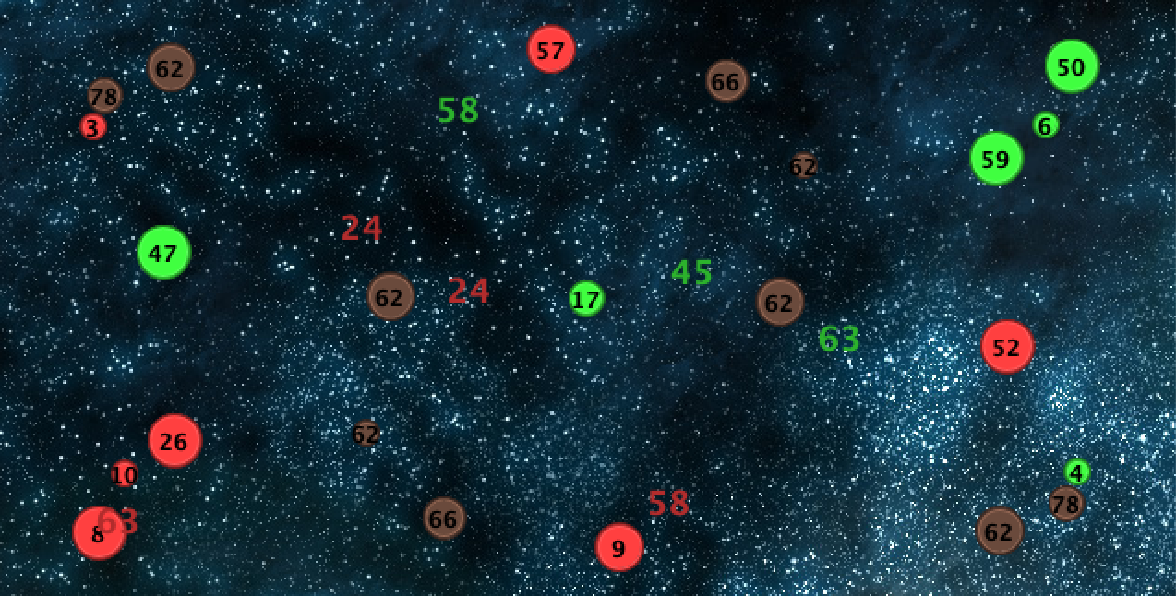

Slide 5
P3 Goal
Design a reactive bot with a single behavior tree.
Win against each unique test bot and your classmates.

Slide 6
Getting Started
May have to install Java JDK:
https://www.oracle.com/java/technologies/javase-jdk15-downloads.html
Before trying to build your bot, watch the test bots play out.
Understand strategies
How can you beat these bots?
Look over bt_bot.py
A basic behavior tree is already provided. You can improve on this or build a new one.
Look at how the tree is assembled
Look at other bot’s code to see how the functions in planet_wars.py can be used

Slide 7
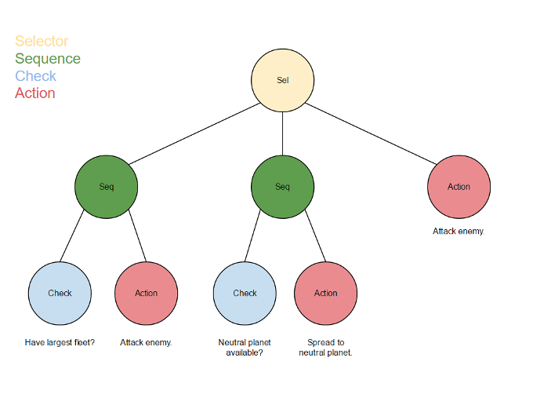
Provided Behavior Tree

Slide 8
Code
Your tree will be assembled in bt_bot.py
Check functions will be defined and implemented in checks.py
Action functions will be defined and implemented in behaviors.py
planet_wars.py
Contains classes for planets, fleets, and the game state PlanetWars.
Contains the functions issue_order and finish_turn
PlanetWars contains all the game’s relevant information and methods for accessing this information

Slide 9
Canvas Link
https://canvas.ucsc.edu/courses/46859/assignments/280059

